Slide 1

Describing Families
Module 3
Module 3. Describing Families
1
Notes:
(Date of slide or last update given at the top of the notes for each slide)
Recognition of the family as an entity that can be recognized in descriptive cataloging is new to general cataloging, although not in archival cataloging practice. Families are now recognized as potential creators of or contributors to works and expressions, and are recognized having other types of relationships with works, expressions, manifestations, and items.

Slide 2
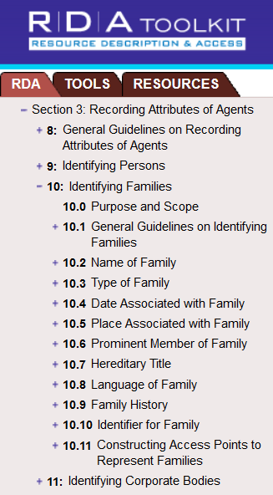
RDA Chapters 8 and 10
Notes:
March 20, 2017
Guidelines for describing families in authority records are found in RDA Chapters 8 and 10.

Slide 3
Families as creators
Families create records (archives)
Families create serials (e.g. newsletters)
Families create monographs (e.g. a family cookbook)
Families create Internet resources (e.g. family websites or blogs)
Notes:
May 1, 2013
Families can be creators of works in a number of ways, including those listed here.

Slide 4
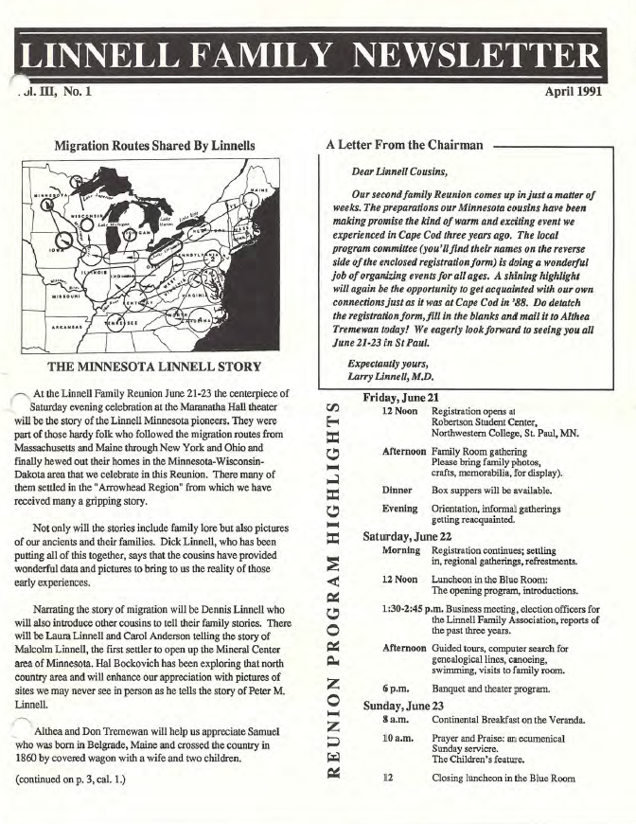
Serial
Notes:
May 1, 2013
[Source: http://www.linnellfamilyassociation.com/Newletters/April_1991.pdf]

Slide 5
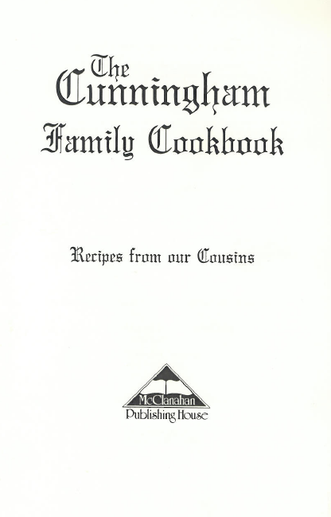
Monograph
1997
Notes:
May 1, 2013
This is the title page.
This cookbook contains 400 recipes from Cunningham cousins, the descendants of William and Nancy Carr Cunningham of Trigg County, Kentucky, and includes photos and a brief family history.

Slide 6
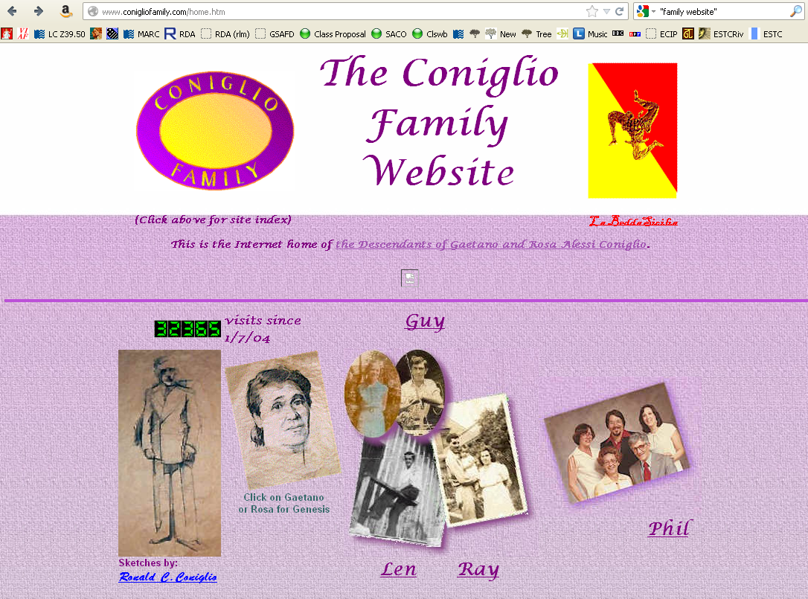
Website
Notes:
May 1, 2013
This is a website created by the family for the descendants of Gaetano and Rosa Alessi Coniglio.
[Source: http://www.conigliofamily.com/home.htm]

Slide 7
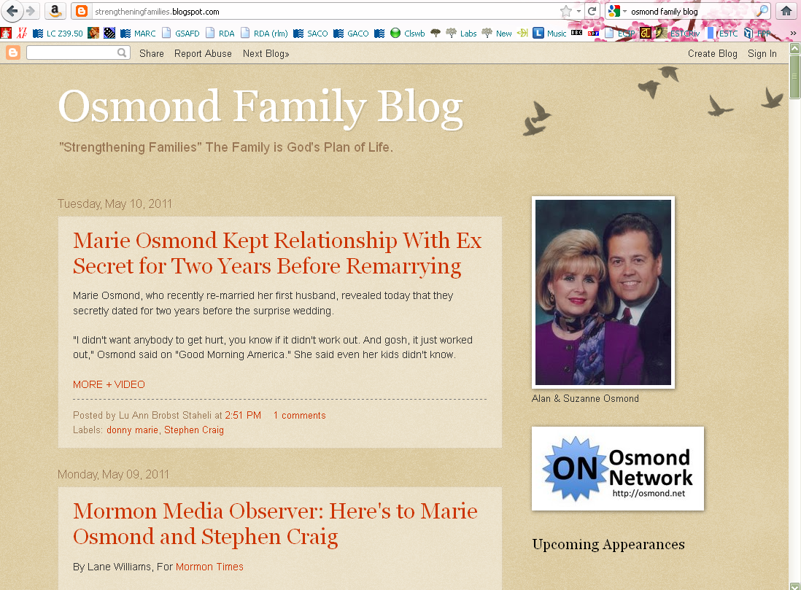
Blog
Notes:
May 1, 2013
View of Osmond family blog, May 2011.

Slide 8
Families as contributors, etc.
Families can be contributors to an expression, or may be associated with manifestations and items as well, for example, as
  Performers
  Publishers
  Owners
Notes:
March 20, 2017
In addition to these, there are many other ways families can be related to works, expressions, manifestations, or items.

Slide 9
Families as subjects
Families can also be subjects of works
Former LC policy: only use LCSH family name forms in 600 fields, even in RDA records.
Family name records were coded as not valid for use as subjects and included
  667 SUBJECT USAGE: This name is not valid for use as a
  subject; use a family name heading from LCSH.
THIS POLICY CHANGED in February 2024.
See SHM H 1631 https://www.loc.gov/aba/publications/FreeSHM/H1631.pdf
Notes:
May 15, 2024: revised slide to change the policy information
August 9, 2019: added instructor note with text from SHM H 1631 and note about alternative coding of RDA family name access points as subjects
March 20, 2017: added URL to speaker notes
December 15, 2016: added SHM reference
SHM H 1631 Genealogy and Family Names (https://www.loc.gov/aba/publications/FreeSHM/H1631.pdf)
Note: Under AACR2, family names could not be established in the name authority file because they could not be descriptive access points. RDA permits family names to be used as descriptive access points if the family is credited with the creation of a work. They may therefore be established in the name authority file.
In addition to an RDA access point, a heading needed for use as a subject should be established in LCSH and tagged 100. Once established, the heading is used for works about all families with that name and is not specific to a particular family in a particular place or time.
A heading needed for use as an RDA descriptive access point should be established in the name authority file and also tagged 100.
Example:
Subject heading: 100 3# $a Smith family
400 3# $a Smythe family
Name heading: 100 3# $a Smythe (Family : $d 1745-1995 : $c Providence, R.I.)

Slide 10
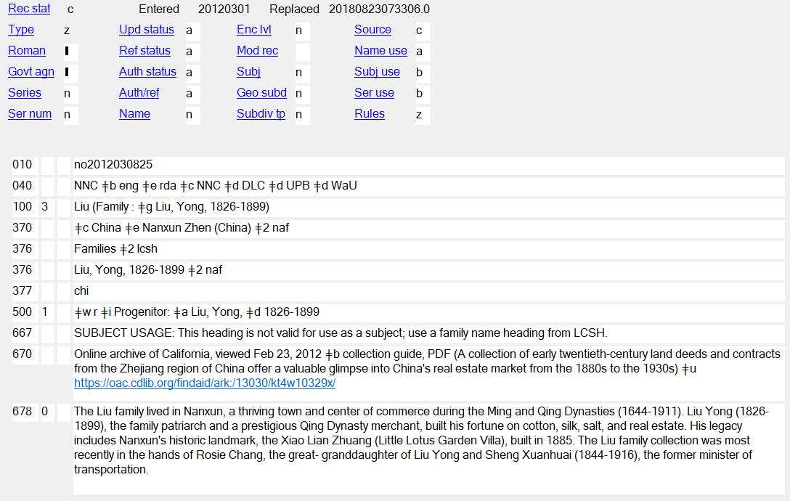
Notes:
October 4, 2024: added instructor note about revising
May 15, 2024: changed policy info
September 17, 2018
This is what this family NAR looked like under the former policy.
This family is a creator of an archival collection.
If revising this name authority for any reason, delete the 667 field and change the values of Subj and Subj use to “a”.

Slide 11
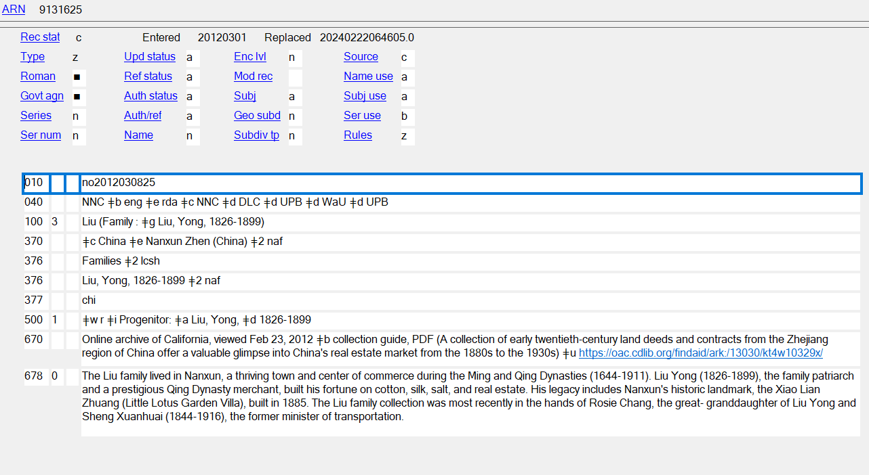
Bibiographic record:
  600 30 Liu (Family : ǂg Liu, Yong, 1826-1899)
  600 30 Liu family.
Notes:
October 4, 2024: updated instructor note
May 15, 2024
This is what the revised NAR looks like under the new policy—Subj and Subj Use have been changed to “a”; the 667 note has been removed. This form may be used as a subject heading in a PCC record.
NOTE: under the new policy RDA family name forms should always be paired in PCC bibliographic records with the more general family name form found in LCSH. That means that a library may also have to submit a SACO proposal to establish a generic family name heading in LCSH.

Slide 12
100 3_ Agen (Family : $g Agen, John Bernard, 1856-1920), $e creator.
245 10 Agen family papers.
264 _0 $c 1904-1978.
520 2_ Financial records, photographs, maps, date books, journals, gardening related
papers and magazines, clippings, programs, and miscellaneous papers.
545 0_ John Bernard Agen (1856-1920) was a wealthy entrepreneur in Seattle in the
early 20th century. He came to Seattle shortly after the Great Fire of 1889. He
started the Mount Vernon Milk Company in the Skagit Valley, and soon began
exporting condensed milk to the Far East and Alaska. Agen married Florence
Ryan in 1900 and they had three children: Katherine, Florence and James.
John Agen's daughter Katherine (1901-1991) married into the Baillargeon
family in 1923, who were another powerful and wealthy entrepreneurial family
in Seattle. Her husband Cebert Baillargeon died in 1964. In her lifetime she
helped establish the Seattle Art Museum, was a member of the National
Council of the Metropolitan Opera, and served as co-chairwoman of the Met’s
first auditions in the Pacific Northwest.
600 30 Agen (Family : $g Agen, John Bernard, 1856-1920) $v Archives.
600 30 Agen family $v Archives.
600 10 Agen, John Bernard, $d 1856-1920 $v Archives.
600 10 Baillargeon, Katherine, $d 1901-1991 $v Archives.
650 _0 Businesspeople $z Washington (State) $z Seattle.
650 _0 Women benefactors ǂz Washington (State) $z Seattle.
650 _0 Gardening $z Washington (State) $z Seattle.
655 _7 Records (Documents) $2 lcgft
Notes:
May 15, 2024: revised to reflect new policy
November 22, 2019
Bibliographic record illustrating that an RDA family name access point can be used in a 100 or 700 field as a creator or contributor, and in the 600 field the RDA form is paired with an LCSH heading is used for works about all families with that name. The established LCSH heading is sort of like an undifferentiated family subject heading.

Slide 13
MARC Coding
Families are coded in X00 with first indicator “3”
As with other authority records, RDA records for families are coded “z” in 008/10 (“Rules”) and “rda” in 040 subfield $e
Notes:
March 1, 2020: corrected typo in first bullet

Slide 14
Notes:
September 17, 2018
The Liu family again

Slide 15
Definition
RDA 8.1.2: The term family refers to two or more persons related by birth, marriage, adoption, civil union, or similar legal status, or who otherwise present themselves as a family
It also includes larger groups such as dynasties, clans, or royal houses
Notes:
May 1, 2013

Slide 16
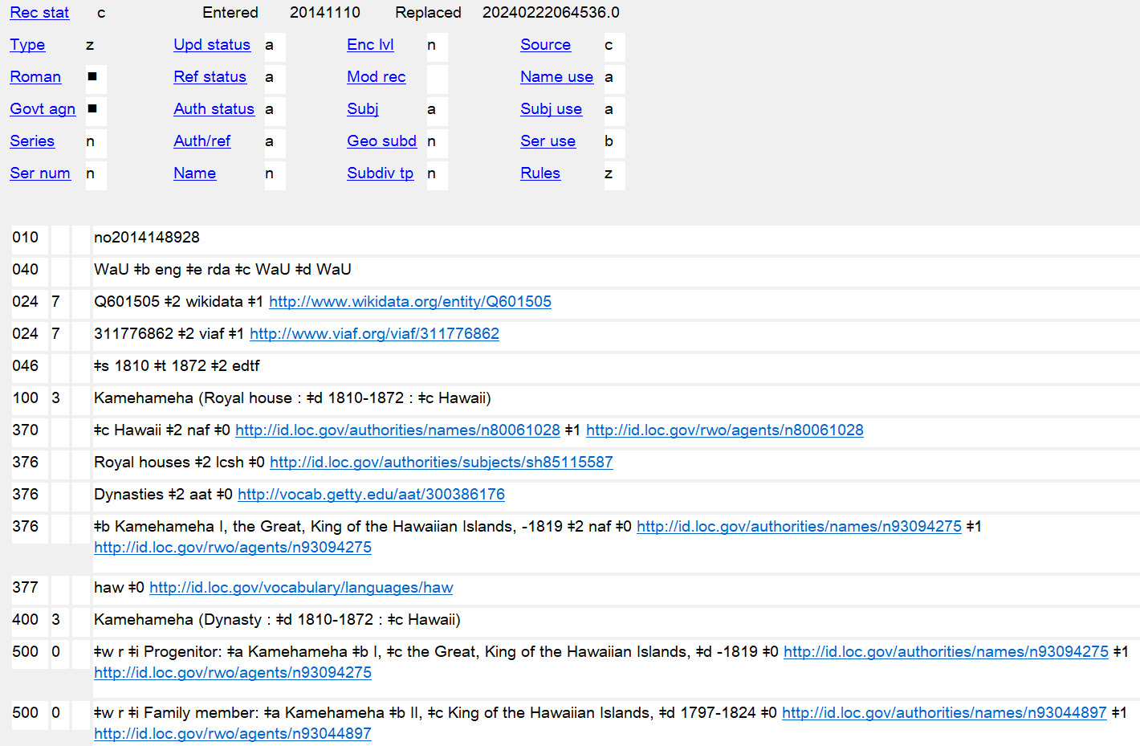
Notes:
October 4, 2024: replaced screenshot with updated one
March 1, 2020: new slide
Families include larger groups such as dynasties, clans, and royal houses. The slide shows an example of an authority record for a royal house.
Since the Kamehameha royal house is also called a dynasty in some sources, a variant access point was made with Dynasty as the type of family qualifier.

Slide 17
Family vs. Corporate Body
Families can be related to organizations. Such organizations are corporate bodies:
  100 3_ $a Hoopes (Family : $g Hoopes, Joshua, 1645-1723)
  110 2_ $a Hoopes Family Organization
  100 3_ $a Osmond (Family : $g Osmond, George, 1917-2007)
  110 2_ $a Osmonds (Musical group)
Notes:
December 15, 2016
Be careful to distinguish between a family entity and a corporate body entity, such as a family organization or singing group.

Slide 18
RDA Core Elements for Families
RDA 0.6.7
Always core if the information is known
  Preferred name for the family
  Type of family
  Date associated with the family
  Identifier for the family
Core if necessary to distinguish
  Place associated with the family
  Prominent member of the family
Notes:
March 20, 2017: updated speaker notes
Remember “core” does not necessarily mean the information has to become part of the authorized access point. It simply means it must be recorded as part of the description if applicable and readily ascertainable.

Slide 19
Exercise
What core or other elements can you identify about the Coniglio Family?
Notes:
May 1, 2013
See information on the following two slides about the Coniglio family.

Slide 20
Notes:
May 1, 2013
Preferred name of the family: Coniglio [note the word “family” is not considered part of the name in RDA]
Type of family: family
Prominent member(s) of the family: Gaetano Coniglio, Rosa Alessi Coniglio. Note in this case the prominent members are also the progenitors of the family (see RDA Appendix K.2.2). This element is commonly used to record progenitors, but other prominent members of the family can also be recorded.
[Presenter: when finished here “click” on the picture of Gaetano or Rosa for more]
[Source: http://www.conigliofamily.com/home.htm]

Slide 21
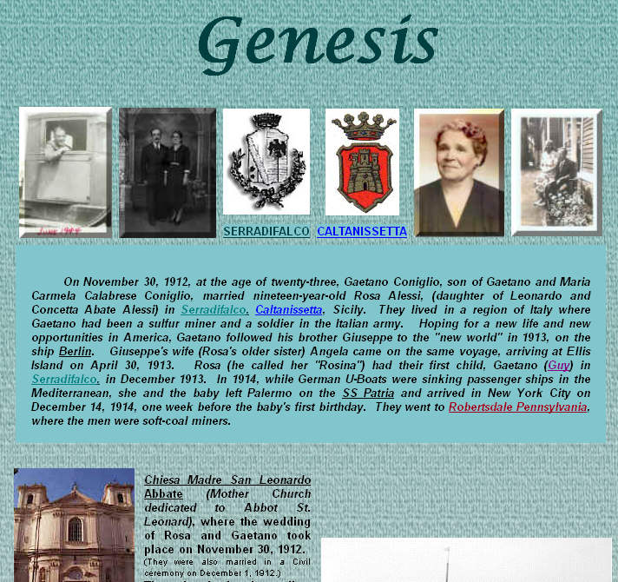
Notes:
May 1, 2013
Other core information:
Date associated with the family: November 30, 1912 (date of marriage, can be considered the date the family began); arrival in America (April 30, 1913)--cataloger judgment, but this might instead be considered the beginning of this particular American Coniglio family. A date of marriage if available might be more appropriate for most families that define themselves as the descendants of a couple.
Place(s) associated with the family: Serradifalco, Italy; Robertsdale, Pennsylvania
[Source: http://www.conigliofamily.com/Genesis.htm]

Slide 22
Identifying Families: Transcription and Capitalization
8.5.2. Capitalization: follow Appendix A.2
8.5.4. Diacritical marks: record them as they appear; add them if it is certain that they are integral to the name but were omitted in the source
8.5.5. Retain hyphens if used by the family
8.5.6. Instructions about spacing between initials
8.5.7. Abbreviations. Follow the usage of the familiy
8.4. Language and script. NACO policy = Romanize vernacular scripts.
Notes:
November 24, 2015
Go to 8.5.1; have someone read, especially 8.5.6.1. Then go to Appendix A.2 & B.2 and examine together.

Slide 23
RDA 8.12. Source Consulted
Record in 670 field, or 3XX $u/$v
Always include one 670 for the work being cataloged
Others included if needed to justify information in the description
Suggested format:
  670 Title proper, date: $b location within source (data)
Notes:
May 1, 2013
Everyone go to RDA 8.12.

Slide 24
670 field examples
  670 Letters and papers of the Verney family down to the end of the year 1639, 2011.
670 Correspondance des Borgia, 2013.
670 Brock family papers, 1801-1904 (bulk 1840s-1880s)
670 Warmed by the hearthstone, 2011: $b title page (the Moran family)
670 Grey, I. The Romanovs, 1970: $b preface (Romanov dynasty; 17-20th centuries; Mikhail Fedorovich Romanov elected Tsar in 1613 at age 16)
670 Dinastii͡a Romanovykh, 2006: $b title page (Династия Романовых = Dinastii͡a Romanovykh)
670 Barlow (Family). John Lawson Barlow family letters, 1855-1948: $b finding aid (Barlow family)
670 OCLC, June 16, 2012 $b (usage: Atholl family)
670 Wikipedia, July 17, 2013: $b House of Borgia (Borgia family; aka Borja, Borjia, Borges; came from Valencia, Spain; became prominent during Renaissance in Italy; well-known in ecclesiastical and political affairs in the 15th and 16th centuries; Alfons de Borja ruled as Pope Calixtus III, 1455-1458; Rodrigo Lanzol Borgia was Pope Alexander VI, 1492-1503; under Alexander VI suspected of adultery, simony, theft, rape, bribery, incest, murder, had many enemies; patrons of the arts)
Notes:
August 9, 2019: added date of publication of first example. Removed “$a” in all examples, since we don’t show it elsewhere. Added some new examples
Explain the OCLC 670.
There are lots of ways to form these. The point is, record information justifying what you’ve included in other elements in the description.

Slide 25
Identifying Families: Sources
Where can we get information about families?
  10.1.1: Take the name or names of the family from any source; take information on other identifying attributes from any source
Notes:
May 1, 2013

Slide 26
Identifying Families: Sources
Sources to check
  The resource you are cataloging
  The LC/NACO Authority File (authorities.loc.gov)
  Your database (e.g. OCLC)
  Optional: Other useful sources
    The family’s own web page
    Virtual International Authority File (http://viaf.org)
    Wikipedia (http://www.wikipedia.org/)
    Other sources such as encyclopedias and dictionaries
    FamilySearch.org
    ancestry.com
Notes:
December 15, 2016: added family web page
Presenter: pause here and discuss possible sources for information about families:
ancestry.com
http://www.ancestry.com/
Pay database containing thousands of collections of genealogical records, including public and private records for individuals and families. Some duplication with FamilySearch.
RootsWeb
http://www.rootsweb.ancestry.com/
Shared database sponsored by ancestry.com containing genealogies contributed by users.
FamilySearch
https://familysearch.org/
Free database containing thousands of collections of genealogical records, including public and private records for individuals and families. Some duplication with ancestry.com. Also contains user-contributed genealogies.
Cyndi’s List
http://www.cyndislist.com/
Growing listing of links to genealogical resources on the Internet.

Slide 27
Exercise
Take three worksheets or open three work forms
Record the source consulted element(s) in one or more 670 fields for the Coniglio, Cunningham, and Linnell familes
Notes:
May 1, 2013

Slide 28
Notes:
May 1, 2013
Information about the Coniglio family

Slide 29
Notes:
May 1, 2013
More information about the Coniglio family

Slide 30
Source Consulted (Coniglio)
670 The Coniglio family website, 8 April 2014 $b (Coniglio family, descendants of Gaetano and Rosa Alessi Coniglio, who married 30 November 1912 in Serradifalco, Italy and emigrated to the United States 30 April 1913; the family settled in Robertsdale, Pennsylvania)
Notes:
November 25, 2015

Slide 31
1997
Notes:
March 1, 2019: added publication date to slide
Title page of The Cunningham Family Cookbook. Added date of publication to the image.

Slide 32
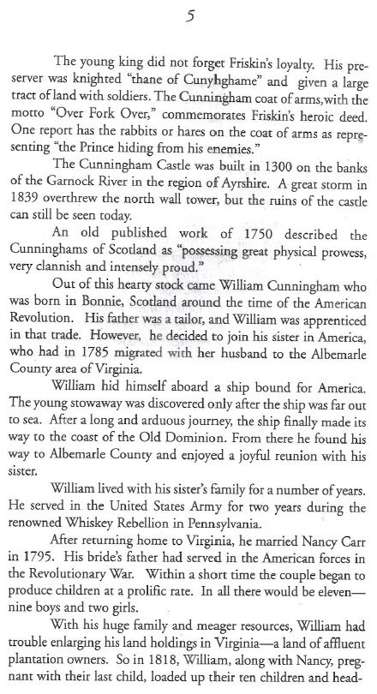
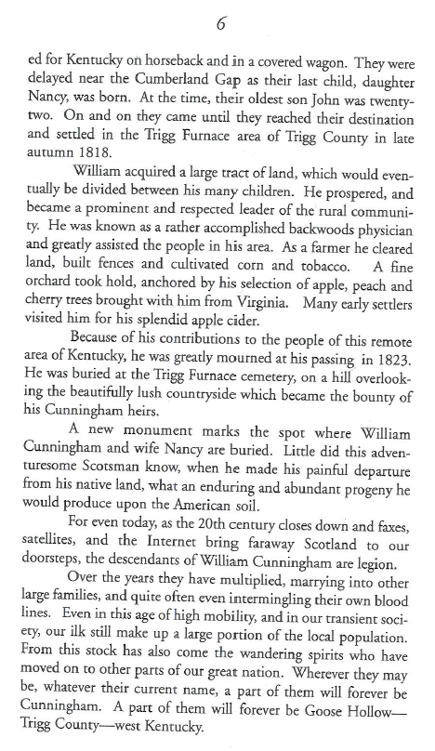
Further information about the Cunningham family, from p. 5-6 of the book
Notes:
May 1, 2013
Information:
Head of family: William Cunningham & Nancy Carr
William immigrated to the U.S. from Scotland after 1785, married Nancy Carr in 1795 in Virginia.
The family moved to Trigg County, Kentucky in 1818, where the family remained.
It’s clear from this preface that the Cunningham Family in this context refers to the descendants of William and Nancy Cunningham of Trigg County, Kentucky.

Slide 33
Source Consulted (Cunningham)
670 The Cunningham family cookbook, 1997: $b pages 5-6 (descendants of William and Nancy Cunningham. William emigrated from Scotland some time after 1785 and married Nancy Carr in 1795. The family settled in Trigg County, Kentucky in 1818)
Notes:
March 20, 2017: added date they settled in Trigg County to justify including this later.

Slide 34
Notes:
May 1, 2013
Information about the Linnell family
[Source: http://www.linnellfamilyassociation.com/Newletters/April_1991.pdf]
Note: for 670, the first newsletter was March 1989, but this is issue April 1991.

Slide 35
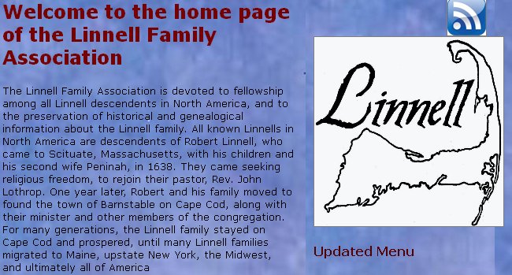
Further information about the Linnell family, from the Linnell Family Association website:
Notes:
May 1, 2013
[Source: http://www.linnellfamilyassociation.com/]

Slide 36
Sources Consulted (Linnell)
670 Linnell family newsletter, April 1991.
670 Linnell Family Association website, 8 April 2014 $b (The Linnell family consists of all Linnells in North America, all presumed to be descendants of Robert Linnell, who came to Scituate, Massachusetts with his children and second wife in 1638. The family later settled on Cape Cod)
Notes:
March 1, 2018: revised format of first 670

Slide 37
Choosing and Recording the Preferred Name
The preferred name should be the commonly known form of the name (RDA 10.2.2)
Forms found in preferred sources of information (e.g. title pages of books) are assumed to be the commonly known form, but other evidence may contradict this
Notes:
May 1, 2013
Read RDA 10.2.2.3 together, then 10.2.2.2. The basic guideline is 10.2.2.3, especially the first sentence; 10.2.2.2 is the default; RDA assumes that forms found in preferred sources of information are the commonly known forms, so such sources have greater weight than others. However, the cataloger must weigh all the available evidence.
Reminder if needed (if this module is being given independently, or if the reminder hasn’t already been given in a previous module such as personal names)-- Have a look at RDA 2.2.2 to see what the preferred sources of information are. The preferred source of information for a website (for the Coniglio family) is found in 2.2.2.4: embedded metadata (which would include just about everything in the website, including wording on the title page) or any source “forming part of the resource itself.”

Slide 38
Preferred Name Chosen from Preferred Sources
Linnell
Cunningham
1997
Notes:
May 1, 2013
Title page of the Cunningham Family Cookbook. Publication date = 1997.
[Source: http://www.linnellfamilyassociation.com/Newletters/April_1991.pdf]
Note: for 670, the first newsletter was March 1989 but this is issue April 1991

Slide 39
Attributes of Families: Preferred Name (MARC)
Most RDA entity attributes have a discrete place in MARC to record them. Preferred name goes into the general field, 670
Record in the MARC authorities format 100 field, first indicator 3
Record the preferred name in subfield $a
Notes:
May 1, 2013
LOOK AT MARC authority format 100 field.
Note: Subfield $a is implied in the OCLC display if it is the first subfield (see following slide)

Slide 40
Preferred Name (RDA 10.2.2)
The preferred name is recorded in direct order in the 100 field of the authority record
100 3_ Duvall
100 3_ Larsen
Record the preferred names for the three families we have worked on so far on your work forms
Notes:
December 15, 2016
They should record:
100 3_ Coniglio
100 3_ Linnell
100 3_ Cunningham

Slide 41
Preferred Name (Coniglio)
100 3_ Coniglio
670 The Coniglio family website, 8 April 2014 $b (Coniglio family, descendants of Gaetano and Rosa Alessi Coniglio, who married 30 November 1912 in Serradifalco, Italy and emigrated to the United States 30 April 1913; the family settled in Robertsdale, Pennsylvania)
Notes:
November 24, 2015

Slide 42
Preferred Name (Cunningham)
100 3_ Cunningham
670 The Cunningham family cookbook, 1997: $b pages 5-6 (descendants of William and Nancy Cunningham. William emigrated from Scotland some time after 1785 and married Nancy Carr in 1795. The family settled in Trigg County, Kentucky in 1818)
Notes:
March 20, 2017

Slide 43
Preferred Name (Linnell)
100 3_ Linnell
670 Linnell family newsletter, April 1991.
670 Linnell Family Association website, 8 April 2014 $b (The Linnell family consists of all Linnells in North America, all presumed to be descendants of Robert Linnell, who came to Scituate, Massachusetts with his children and second wife in 1638. The family later settled on Cape Cod)
Notes:
March 1, 2019: changed format of first 670.

Slide 44
Preferred Name (RDA 10.2.2)
Different forms of the same name (10.2.2.5)
If family names vary in fullness, language, script, or spelling, follow the instructions for personal names (9.2.2)
  Valera y Alcalá Galiano vs. Valera
  Knef vs. Neff
  Melanchthon vs. Schwarzerd
  Kohen-Asif vs. כהן־אסיף
Notes:
May 1, 2013

Slide 45
Preferred Name (RDA 10.2.2)
Different names for the same family (10.2.2.6)
If family goes by different names and has not changed its name, choose the most commonly known form
  Bonello vs. Tal Korkos
  Conte vs. Tamburra
  Amirault vs. Tourangeau
Notes:
May 1, 2013
Bonello vs. Tal Korkos: a Maltese surname and a family nickname [source: http://www.maltainsideout.com/1531/whats-in-a-name-a-lot-if-its-malta/]
Conte vs. Tamburra: an Italian surname and a soprannome [source: http://www.laroccalulett.com/Nicknames.html]
Amirault vs. Tourangeau: an Acadian surname and a “dit” name [source: http://www.eogen.com/acadianditnames].
From “What Is a Dit Name?” [https://www.thoughtco.com/what-is-a-dit-name-3972358]: A dit name is essentially an alias, or alternate name, tacked on to a family name or surname. Dit (pronounced "dee") is a French form of the word dire, which means "to say," and in the case of dit names is translated loosely as "that is to say,“ or "called." Therefore, the first name is the family's original surname, passed down to them by an ancestor, while the "dit" name is the name the person/family is actually "called" or known as. … A dit name can be legally used to replace the family's original surname. Sometimes the two surnames may be linked as one family name, or you may find families who use the two surnames interchangeably. Thus, you may find an individual's name recorded with a dit name, or under either just the original surname or just the dit name. Dit names may also be found reversed with the original surname, or as hyphenated surnames.

Slide 46
Preferred Name (RDA 10.2.2)
Change of name (10.2.2.7)
If a family changes its name, create a new record for the new name. Use the earlier form with resources associated with it; and the later form with resources associated with it
Similar to corporate body name change
    Battenberg => Mountbatten
    Saxe-Coburg and Gotha => Windsor
Notes:
March 3, 2020: updated notes
Because of anti-German sentiment the Battenberg family changed its name to Mountbatten on 14 July 1917. [Source: http://en.wikipedia.org/wiki/Mountbatten]
Another example: The House of Windsor is the royal house of the United Kingdom and the other Commonwealth realms. It was founded by King George V by royal proclamation on 17 July 1917, when he changed the name of his family from the German Saxe-Coburg and Gotha (a branch of the House of Wettin) to the English Windsor, due to the anti-German sentiment in the British Empire during World War I. [Source: http://en.wikipedia.org/wiki/House_of_Windsor]
Note: the MARC coding for earlier/later family name will be simple see also references (see slide 94).

Slide 47
Preferred Name (RDA 10.2.2)
Treatment of surnames (10.2.2.8)
Compound surnames and surnames with separately written prefixes are treated the same as for personal names (9.2.2.10-12)
  Lloyd George not George
  Von Braun vs. Braun [depends on nationality]
  D’Anvers vs. Anvers [depends on nationality]
Notes:
May 1, 2013

Slide 48
Variant name (RDA 10.2.3)
The same types of variants can occur for family names as occur for personal names
Variant names are recorded in subfield $a of a MARC 400 field
  100 3_ Carragher ...
  400 3_ Caragher ...
  400 3_ Caraher ...
  400 3_ Carraher ...
Notes:
December 15, 2016
Note: Subfield $a is implied in the OCLC display if it is the first subfield.

Slide 49
Type of Family (RDA 10.3)
Type of family is defined as “a categorization or generic descriptor for the type of family.”
  Family
  Clan
  Tribe
  Sept
  Dynasty
  Kindred group
The type of family element is core (required)
Notes:
May 1, 2013
Since this is a new concept to most, carefully read the definition.
In case anyone asks, “sept” is a division of a Scottish or Irish clan.

Slide 50
Type of Family (RDA 10.3)
Record Type of Family as an element in 376 subfield $a. Prefer controlled vocabulary (DCM Z1 376).
376 Families $2 lcsh
376 Dynasties $2 aat
376 Royal houses $2 lcsh
376 Clans $2 afset
Notes:
October 4, 2024: changed $2 coding in first example to lcsh because the LCDGT term was changed from Families to Family members, which is no longer appropriate to use as a type of family
March 1, 2020: added two more examples
February 5, 2019: changed to $2 lcdgt to encourage usage of LCDGT
The Type of Family element should be recorded in a 376 field and is a required part of the authorized access point. Other elements may be included at the discretion of the cataloger. At least enough elements must be included to distinguish the family from others with the same name and type of family, but the choice of the distinguishing elements is up to the cataloger’s judgment.
In case anyone asks about $2 code “afset”, it is for the American Folkore Society Ethnographic Thesaurus, a controlled vocabulary hosted by LC’s Linked Data Service.

Slide 51
Type of Family (RDA 10.3)
Record the type of family element in your worksheets or work forms
Notes:
February 5, 2019: changed to $2 lcdgt to encourage usage of LCDGT
They should record in each worksheet or work form:
376 Families $2 lcdgt

Slide 52
Type of Family (Coniglio)
100 3_ Coniglio
376 Families $2 lcsh
670 The Coniglio family website, 8 April 2014 $b (Coniglio family, descendants of Gaetano and Rosa Alessi Coniglio, who married 30 November 1912 in Serradifalco, Italy and emigrated to the United States 30 April 1913; the family settled in Robertsdale, Pennsylvania)
Notes:
October 4, 2024: changed $2 to lcsh because Families is no longer a valid heading in LCDGT (changed in 2024 to Family members)
February 5, 2019: changed to $2 lcdgt to encourage usage of LCDG.

Slide 53
Type of Family (Cunningham)
100 3_ Cunningham
376 Families $2 lcsh
670 The Cunningham family cookbook, 1997: $b pages 5-6 (descendants of William and Nancy Cunningham. William emigrated from Scotland some time after 1785 and married Nancy Carr in 1795. The family settled in Trigg County, Kentucky in 1818)
Notes:
October 4, 2024: changed $2 to lcsh because Families is no longer a valid heading in LCDGT (changed in 2024 to Family members)
February 5, 2019: changed to $2 lcdgt to encourage usage of LCDGT

Slide 54
Type of Family (Linnell)
100 3_ Linnell
376 Families $2 lcsh
670 Linnell family newsletter, April 1991.
670 Linnell Family Association website, 8 April 2014 $b (The Linnell family consists of all Linnells in North America, all presumed to be descendants of Robert Linnell, who came to Sciutate, Massachusetts with his children and second wife in 1638. The family later settled on Cape Cod)
Notes:
October 4, 2024: changed $2 to lcsh because Families is no longer a valid heading in LCDGT (changed in 2024 to Family members)
February 5, 2019: changed to $2 lcdgt to encourage usage of LCDGT

Slide 55
Date Associated with the Family
(RDA 10.4)
The Date Associated with the Family element is also core, but may not be known.
  Might be marriage date of an ancestor couple
  Might be birth of first child of an ancestor couple
  Might be a date of immigration of an ancestor
  Includes dates of dynasties, royal houses, etc.
  Can be approximate or century/range of centuries
Notes:
October 4, 2024: added last bullet in slide
May 1, 2013
Note the dates do not necessarily need to be precise--for example, with a dynasty, especially one far back in history, dates might be approximate, such as a century or range of centuries.

Slide 56
Date Associated with the Family
(RDA 10.4)
Except for century dates, this element is recorded in MARC 046 in the format YYYY-MM-DD or YYYY-MM or YYYY (using the EDTF format).
EDTF format: http://www.loc.gov/standards/datetime/. See this website for more complex situations.
Century dates do not use the EDTF format. Simply record the first two digits of the century (e.g. “19” = all dates beginning with “19” = 20th century)
If known, this element must be recorded. It is recorded in the 046 field ($s is the beginning date, $t is the end)
046 $s 1811 $2 edtf
Notes:
November 24, 2015

Slide 57
Date Associated with the Family
(RDA 10.4)
Record the Date Associated with the Family element(s) for the Linnell, Cunningham, and Coniglio families in 046
Notes:
October 4, 2024: changed $2 to lcsh because Families is no longer a valid heading in LCDGT (changed in 2024 to Family members)
February 5, 2019: changed to $2 lcdgt to encourage usage of LCDGT
This information should already be recorded in the participants’ 670 fields.
046 $s 1795 [or you might choose 1818, when they arrived in Kentucky] $2 edtf
100 3_ Cunningham …
376 Families $2 lcsh
046 $s 1912-11-30 [or 1913-04-30] $2 edtf
100 3_ Coniglio …
376 Families $2 lcsh
046 $s 1638 $2 edtf
100 3_ Linnell …
376 Families $2 lcsh

Slide 58
Date Associated with the Family (Coniglio)
046 $s 1912-11-30 [or 1913-04-30] $2 edtf
100 3_ Coniglio
376 Families $2 lcsh
670 The Coniglio family website, 8 April 2014 $b (Coniglio family, descendants of Gaetano and Rosa Alessi Coniglio, who married 30 November 1912 in Serradifalco, Italy and emigrated to the United States 30 April 1913; the family settled in Robertsdale, Pennsylvania)
Notes:
October 4, 2024: changed $2 to lcsh because Families is no longer a valid heading in LCDGT (changed in 2024 to Family members)
February 5, 2019: changed to $2 lcdgt to encourage usage of LCDGT.

Slide 59
Date Associated with the Family (Cunningham)
046 $s 1795 [or you might choose 1818, when they arrived in Kentucky] $2 edtf
100 3_ Cunningham
376 Families $2 lcsh
670 The Cunningham family cookbook, 1997: $b pages 5-6 (descendants of William and Nancy Cunningham. William emigrated from Scotland some time after 1785 and married Nancy Carr in 1795. The family settled in Trigg County, Kentucky in 1818)
Notes:
October 4, 2024: changed $2 to lcsh because Families is no longer a valid heading in LCDGT (changed in 2024 to Family members)
February 5, 2019: changed to $2 lcdgt to encourage usage of LCDGT

Slide 60
Date Associated with the Family (Linnell)
046 $s 1638 $2 edtf
100 3_ Linnell
376 Families $2 lcsh
670 Linnell family newsletter, April 1991.
670 Linnell Family Association website, 8 April 2014 $b (The Linnell family consists of all Linnells in North America, all presumed to be descendants of Robert Linnell, who came to Scituate, Massachusetts with his children and second wife in 1638. The family later settled on Cape Cod)
Notes:
October 4, 2024: changed $2 to lcsh because Families is no longer a valid heading in LCDGT (changed in 2024 to Family members)
February 5, 2019: changed to $2 lcdgt to encourage usage of LCDGT
March 1, 2019: changed format of first 670

Slide 61
Place Associated with the Family
(RDA 10.5)
The Place Associated with the Family element is recorded in the 370 field
370 $e Australia $2 naf
370 $e Kraków (Poland) $2 naf
370 $e Long Island (N.Y.) $2 lcsh
370 $f Badlands (S.D. and Neb.) $2 lcsh
Notes:
March 1, 2019: changed subfield $f to subfield $e and added speaker note about subfield coding
Record the place name in the 370 field using the authorized access point for the place name, followed by subfield $2 with the source of the name (generally it will be a jurisdiction from the LC/NACO Authority File, so subfield $2 naf, but it could be a place name from LCSH or another vocabulary. If the place name is recorded in the authorized access point, use the form that the place name would take if used as an addition to a corporate body. For example:
100 3_ Bland (Family : $d 1880-1899 : $c Richmond, Va.)
370 $e Richmond (Va.) $2 naf
The subfield coding could also be subfield $f or subfield $c (for a country) depending on the situation.
Note to presenter: If the foundations module has just been presented, these slides may be summarized.

Slide 62
Recording the Place Attribute
Place is recorded in MARC 370
  Associated country - $c
  Place of residence - $e
  Other associated place - $f
Notes:
November 24, 2015
LOOK AT MARC

Slide 63
Recording the Place Attribute
The form of the place name is governed by RDA Chapter 16.
Authorized access points for jurisdictional place names are generally formed as in AACR2, e.g. “Paris (France)”
LC/PCC Practice: record in 370 exactly as established in the NAF, LCSH, or other controlled vocabulary
If the place has been taken from an authority file/controlled vocabulary, include $2 with the appropriate source code (e.g., naf, lcsh, fast, etc.)
Notes:
August 9, 2019: added that places can come from LCSH or other vocabularies as well as NAF
Important reminder from the earlier session

Slide 64
Recording the Place Attribute
For jurisdictions and other places found in the LC/NAF, use the authorized access point as found, with source in $2
370 $e London (England) $2 naf [place of residence]
370 $f Mexico City (Mexico) $2 naf [other associated place]
370 $e Austin (Tex.) $2 naf [place of residence]
370 $f Ontario (Calif.) $2 naf [other associated place]
370 $e Arizona $2 naf [place of residence]
370 $e Washington (D.C.) $2 naf [place of residence]
370 $c United States $2 naf [associated country]
370 $e Auckland (N.Z.) $f Puerto Rico $c France $2 naf
[place of residence, other associated place, associated country]
370 $e South Boston (Boston, Mass.) $2 naf [place of residence]
Notes:
Updated August 12, 2019: changed District of Columbia to Washington (D.C.); added city section example; added info from DCM Z1 to notes
Remember for the moment we are required to use forms as established using the English rules. Note that 370 can be repeated, or alternately subfields can be repeated within a single 370.
DCM Z1 370: For jurisdictions or other place names with authority records in the LC/NAF, use the authorized access point form as found, recording the source in subfield $2.

Slide 65
Recording the Place Attribute
For non-jurisdictions, prefer names from an authorized vocabulary such as LCSH and give source in $2
370 $e Oregon, Eastern $2 lcsh
370 $e Palouse River Valley (Idaho and Wash.) $2 lcsh
370 $e Nantucket Island (Mass.) $2 lcsh
370 $e Ural Mountains Region (Russia) $2 lcsh
370 $e Western Balkans $2 wikidata
370 $f Central America $2 fast
370 $f Europe--Flanders $2 fast
370 $f Great Basin States $2 atg
370 $f Admiralty Inlet (Nunavut) $2 cash
370 $e Mediterranean Region $2 mesh
370 $e French West Indies $2 eurovocen
Notes:
October 4, 2024: added Wikidata example
August 12, 2019
For non-jurisdictions, other controlled vocabularies may be used in this field.
DCM Z1 370: For non-jurisdictions, prefer names from an authorized vocabulary such as LCSH and identify the source in subfield $2. If the name is not found in an authorized vocabulary, record it in field 370 without giving a subfield $2 (it is not necessary for SACO participants to submit a subject heading proposal).
$2: Code from: Subject Heading and Term Source Codes.
fast: Faceted application of subject terminology (Dublin, Ohio: OCLC)
atg: Agricultural thesaurus and glossary (Beltsville, MD: National Agricultural Library)
cash: Canadian subject headings (Ottawa, ON: Library and Archives Canada)
mesh: Medical subject headings (Bethesda, MD: National Library of Medicine)
eurovocen: Eurovoc thesaurus (English)

Slide 66
Place Associated with the Family (RDA 10.5)
Record the Place Associated with the Family element(s) for the Cunningham, Linnell and Coniglio families in 370
Notes:
October 4, 2024: changed $2 to lcsh because Families is no longer a valid heading in LCDGT (changed in 2024 to Family members)
February 5, 2019: changed 376 to $2 lcdgt to encourage usage of LCDGT
March 1, 2019: changed 370 subfield coding to $e
Don’t add anything to the authorized access point yet. You can record more than one place associated with the family.
Information about places should already be recorded in participants’ 670 fields.
046 $s 1795 [or you might choose 1818, when they arrived in Kentucky] $2 edtf
100 3_ Cunningham …
370 $e Trigg County (Ky.) $2 naf $s 1818 [NOTE the date]
376 Families $2 lcsh
046 $s 1912-11-30 [or 1913-04-30] $2 edtf
100 3_ Coniglio …
370 $e Serradifalco (Italy) $e Robertsdale (Pa.) $2 naf
376 Families $2 lcsh
046 $s 1638 $2 edtf
100 3_ Linnell …
370 $e North America $e Cape Cod (Mass.) $2 lcsh
370 $e Scituate (Mass.) $e Barnstable (Mass.) $e Massachusetts $e United States $2 naf [all possible, probably not all of them would be recorded]
376 Families $2 lcsh

Slide 67
Place Associated with the Family (Coniglio)
046 $s 1912-11-30 [or 1913-04-30] $2 edtf
100 3_ Coniglio
370 $e Serradifalco (Italy) $e Robertsdale (Pa.) $2 naf
376 Families $2 lcsh
670 The Coniglio family website, 8 April 2014 $b (Coniglio family, descendants of Gaetano and Rosa Alessi Coniglio, who married 30 November 1912 in Serradifalco, Italy and emigrated to the United States 30 April 1913; the family settled in Robertsdale, Pennsylvania)
Notes:
October 4, 2024: changed $2 to lcsh because Families is no longer a valid heading in LCDGT (changed in 2024 to Family members)
February 5, 2019: changed to $2 lcdgt to encourage usage of LCDGT
March 1, 2019: changed 370 subfield coding to $e

Slide 68
Place Associated with the Family (Cunningham)
046 $s 1795 [or you might choose 1818, when they arrived in Kentucky] $2 edtf
100 3_ Cunningham
370 $e Trigg County (Ky.) $2 naf $s 1818
376 Families $2 lcsh
670 The Cunningham family cookbook, 1997: $b pages 5-6 (descendants of William and Nancy Cunningham. William emigrated from Scotland some time after 1785 and married Nancy Carr in 1795. The family settled in Trigg County, Kentucky in 1818)
Notes:
October 4, 2024: changed $2 to lcsh because Families is no longer a valid heading in LCDGT (changed in 2024 to Family members)
March 1, 2019: changed 370 subfield coding to $e

Slide 69
Place Associated with the Family (Linnell)
046 $s 1638 $2 edtf
100 3_ Linnell
370 $e North America $e Cape Cod (Mass.) $2 lcsh
370 $e Scituate (Mass.) $e Barnstable (Mass.) $e Massachusetts $c United States $2 naf [all possible, but probably not all would be recorded]
376 Families $2 lcsh
670 Linnell family newsletter, April 1991.
670 Linnell Family Association website, 8 April 2014 $b (The Linnell family consists of all Linnells in North America, all presumed to be descendants of Robert Linnell, who came to Scituate, Massachusetts with his children and second wife in 1638. The family later settled on Cape Cod)
Notes:
October 4, 2024: changed $2 to lcsh because Families is no longer a valid heading in LCDGT (changed in 2024 to Family members)
February 5, 2019: changed to $2 lcdgt to encourage usage of LCDGT
March 1, 2019: changed format of first 670, changed 370 subfield coding to $e

Slide 70
Prominent Member of the Family
(RDA 10.6)
The Prominent Member of the Family element is recorded in the 376 field subfield $b with no internal subfield coding. Use the established form of a personal name. Prefer controlled vocabulary
376 Families $2 lcsh
376 $b Nibley, Hugh, 1910-2005 $2 naf
Notes:
October 4, 2024: changed $2 to lcsh because Families is no longer a valid heading in LCDGT (changed in 2024 to Family members)
February 5, 2019: changed first 376 to $2 lcdgt to encourage usage of LCDGT
Note in this case that because the controlled terms come from different vocabularies they must be recorded in separate 376 fields.

Slide 71
Prominent Member of the Family (RDA 10.6)
Record the Prominent Member of the Family element(s) for the Cunningham, Linnell and Coniglio families in 376 subfield $b
From LC/NAF:
100 1_ Cunningham, William, $d 1765-1823
100 1_ Cunningham, Nancy, $d 1776-1830
100 1_ Linnell, Robert, $d 1584-1662
Not in LC/NAF: Gaetano Coniglio (1889-1944); Rosa Alessi Coniglio (1893-1972)
Notes:
October 4, 2024: changed $2 to lcsh because Families is no longer a valid heading in LCDGT (changed in 2024 to Family members)
August 12, 2019: added Alessi to Rosa Alessi Coniglio in notes; November 22, 2019: added info on established and unestablished names with dates
March 1, 2019: changed 370 subfield coding to $e
February 5, 2019: changed Families 376 to $2 lcdgt to encourage usage of LCDGT
Don’t add anything to the authorized access point yet. You can record more than one prominent member associated with the family.
Information about prominent members of the families should already be recorded in participants’ 670 fields.
Robert Linnell’s birth and death dates are 1584-1662. The form is the established form of the name, but you are not required to establish the name in order to record it in 376. If a relationship link is recorded between the family and the person (500 field, see below), however, the person’s name will need to be established.
William Cunningham’s dates are 1765-1823; Nancy Cunningham’s dates are 1776-1830; both have been established in the NAF.
Gaetano Coniglio’s dates are 1889-1944; Rosa Alessi Coniglio’s dates are 1893-1972. Neither Coniglio has been established in the NAF.
046 $s 1795 [or 1818] $2 edtf
100 3_ $a Cunningham …
370 $e Trigg County (Ky.) $2 naf $s 1818
376 $a Families $2 lcsh
$b Cunningham, William, 1765-1823 $b Cunningham, Nancy, 1776-1830 $2 naf
046 $s 1912-11-30 [or 1913-04-30] $2 edtf
100 3_ $a Coniglio …
370 $e Serradifalco (Italy) $e Robertsdale (Pa.) $2 naf
376 $a Families $2 lcsh
376 $b Coniglio, Gaetano, 1889-1944 $b Coniglio, Rosa Alessi, 1893-1972
046 $s 1638 $2 edtf
100 3_ $a Linnell …
370 $e North America $e Cape Cod (Mass.) $2 lcsh
370 $e Scituate (Mass.) $e Barnstable (Mass.) $e Massachusetts $c United States $2 naf [all possible, probably not all would be on any one]
376 $a Families $2 lcsh
376 $b Linnell, Robert, 1584-1662 $2 naf

Slide 72
Prominent Member of the Family
(Coniglio)
046 $s 1912-11-30 [or 1913-04-30] $2 edtf
100 3_ Coniglio
370 $e Serradifalco (Italy) $e Robertsdale (Pa.) $2 naf
376 Families $2 lcsh
376 $b Coniglio, Gaetano, 1889-1944 $b Coniglio, Rosa Alessi, 1893-1972
670 The Coniglio family website, 8 April 2014 $b (Coniglio family, descendants of Gaetano and Rosa Alessi Coniglio, who married 30 November 1912 in Serradifalco, Italy and emigrated to the United States 30 April 1913; the family settled in Robertsdale, Pennsylvania)
Notes:
October 4, 2024: changed $2 to lcsh because Families is no longer a valid heading in LCDGT (changed in 2024 to Family members)
August 12, 2019: added Alessi to Rosa Coniglio’s name
March 1, 2019: changed 370 subfield coding to $e
February 5, 2019: changed Famlies 376 to $2 lcdgt to encourage usage of LCDGT
Neither Coniglio has been established in the LC/NACO Authority File, so do not include $2 naf in their 376 field.

Slide 73
Prominent Member of the Family
(Cunningham)
046 $s 1795 [or you might choose 1818, when they arrived in Kentucky] $2 edtf
100 3_ Cunningham
370 $e Trigg County (Ky.) $2 naf $s 1818
376 Families $2 lcsh
376 $b Cunningham, William, 1765-1823 $b Cunningham, Nancy, 1776-1830 $2 naf
670 The Cunningham family cookbook, 1997: $b pages 5-6 (descendants of William and Nancy Cunningham. William emigrated from Scotland some time after 1785 and married Nancy Carr in 1795. The family settled in Trigg County, Kentucky in 1818)
Notes:
October 4, 2024: changed $2 to lcsh because Families is no longer a valid heading in LCDGT (changed in 2024 to Family members)
March 1, 2019: changed 370 subfield coding to $e
February 5, 2019: changed 376 by adding $2 lcdgt to encourage usage of LCDGT

Slide 74
Prominent Member of the Family
(Linnell)
046 $s 1638 $2 edtf
100 3_ Linnell
370 $e North America $e Cape Cod (Mass.) $2 lcsh
370 $e Scituate (Mass.) $e Barnstable (Mass.) $e Massachusetts $c United States $2 naf [all possible, but probably not all would be recorded]
376 Families $2 lcsh
376 $b Linnell, Robert, 1584-1662 $2 naf
670 Linnell family newsletter, April 1991.
670 Linnell Family Association website, 8 April 2014 $b (The Linnell family consists of all Linnells in North America, all presumed to be descendants of Robert Linnell, who came to Scituate, Massachusetts with his children and second wife in 1638. The family later settled on Cape Cod)
Notes:
October 4, 2024: changed $2 to lcsh because Families is no longer a valid heading in LCDGT (changed in 2024 to Family members)
March 1, 2019: changed format of first 670; changed 370 subfield coding to $e
February 5, 2019: changed 376 by adding $2 lcdgt to encourage usage of LCDGT

Slide 75
Hereditary Title (RDA 10.7)
Record a hereditary title associated with the family in direct order and in the plural in 376 subfield $c. The title is not part of the authorized access point.
  100 3_ Shrewsbury (Family : $c Great Britain)
  376 Families $2 lcsh
  376 $c Earls of Shrewsbury
Notes:
October 4, 2024: changed $2 to lcsh because Families is no longer a valid heading in LCDGT (changed in 2024 to Family members)
February 5, 2019: changed 376 by adding $2 lcdgt to encourage usage of LCDGT
Some information about the Earls of Shrewsbury: http://www.hereditarytitles.com/Page24.html

Slide 76
Language of the Family (RDA 10.8)
Language of the Family is a language a family uses in its communications.
Language of the family is recorded in MARC 377, using the MARC language codes, and for languages that don’t have their own MARC code, codes from ISO 639-3, Glottolog, etc.
Notes:
October 4, 2024: expanded second bullet to mention use of other codes
March 20, 2017
Record the same as Language of Person (RDA 9.14).

Slide 77
Language of the Family (RDA 10.8)
Record the Language of the Family element(s) for the Cunningham, Linnell and Coniglio families in 377
Notes:
December 15, 2016

Slide 78
Language of the Family (Coniglio)
046 $s 1912-11-30 [or 1913-04-30] $2 edtf
100 3_ Coniglio
370 $e Serradifalco (Italy) $e Robertsdale (Pa.) $2 naf
376 Families $2 lcsh
376 $b Coniglio, Gaetano, 1889-1944 $b Coniglio, Rosa Alessi, 1893-1972
377 eng
670 The Coniglio family website, 8 April 2014 $b (Coniglio family, descendants of Gaetano and Rosa Alessi Coniglio, who married 30 November 1912 in Serradifalco, Italy and emigrated to the United States 30 April 1913; the family settled in Robertsdale, Pennsylvania)
Notes:
October 4, 2024: changed $2 to lcsh because Families is no longer a valid heading in LCDGT (changed in 2024 to Family members)
August 12, 2019: added Alessi to Rosa Coniglio’s name
March 1, 2019: changed 370 subfield coding to $e
February 5, 2019: changed Families 376 to $2 lcdgt to encourage usage of LCDGT

Slide 79
Language of the Family (Cunningham)
046 $s 1795 [or you might choose 1818, when they arrived in Kentucky] $2 edtf
100 3_ Cunningham
370 $e Trigg County (Ky.) $2 naf $s 1818
376 Families $2 lcsh
376 $b Cunningham, William, 1765-1823 $b Cunningham, Nancy, 1776-1830 $2 naf
377 eng
670 The Cunningham family cookbook, 1997: $b pages 5-6 (descendants of William and Nancy Cunningham. William emigrated from Scotland some time after 1785 and married Nancy Carr in 1795. The family settled in Trigg County, Kentucky in 1818)
Notes:
October 4, 2024: changed $2 to lcsh because Families is no longer a valid heading in LCDGT (changed in 2024 to Family members)
March 1, 2019: changed 370 subfield coding to $e
February 5, 2019: changed 376 by adding $2 lcdgt to encourage usage of LCDGT

Slide 80
Language of the Family
(Linnell)
046 $s 1638 $2 edtf
100 3_ Linnell
370 $e North America $e Cape Cod (Mass.) $2 lcsh
370 $e Scituate (Mass.) $e Barnstable (Mass.) $e Massachusetts $c United States $2 naf [all possible, but probably not all would be recorded]
376 Families $2 lcsh
376 $b Linnell, Robert, 1584-1662 $2 naf
377 eng
670 Linnell family newsletter, April 1991.
670 Linnell Family Association website, 8 April 2014 $b (The Linnell family consists of all Linnells in North America, all presumed to be descendants of Robert Linnell, who came to Scituate, Massachusetts with his children and second wife in 1638. The family later settled on Cape Cod)
Notes:
October 4, 2024: changed $2 to lcsh because Families is no longer a valid heading in LCDGT (changed in 2024 to Family members)
March 1, 2019: 2019 changed format of first 670; changed 370 subfield coding to $e
February 5, 2019: changed 376 by adding $2 lcdgt to encourage usage of LCDGT

Slide 81
Family History (RDA 10.9)
A brief family history may be recorded in a 678 field, with first indicator coded “0”. This element may also be used to define the scope of the family.
  678 0_ The Linnell family consists of all Linnells in North America, all presumed to be descendants of Robert Linnell (1584-1662) who settled in Massachusetts in 1638.
Notes:
December 15, 2016

Slide 82
Family History (RDA 10.9)
Record a Family History element for the Coniglio or Cunningham family in 678
Notes:
Updated January 16, 2015

Slide 83
Identifier for Family (RDA 10.10)
A character string uniquely associated with a family or with an authority record for a family
LCCN associated with an authority record is an identifier, recorded in 010
024 (Other Standard Identifier) can also be included. See NACO 024 Best Practices Guidelines
The element is core, and is usually added to a record automatically (as 010)
Notes:
August 16, 2023: updated notes to indicate that 024 fields may be added.
Dec. 23, 2020: Edited speaker notes to remove references to 024 moratorium.
March 3, 2020: added speaker note about URIs
August 5, 2019: revised first and third bullets
March 1, 2019: added bullet point about 024
Look at RDA 10.10 together (similar to RDA 9.18 for persons)
Third bullet: see NACO 024 Best Practices Guidelines

Slide 84
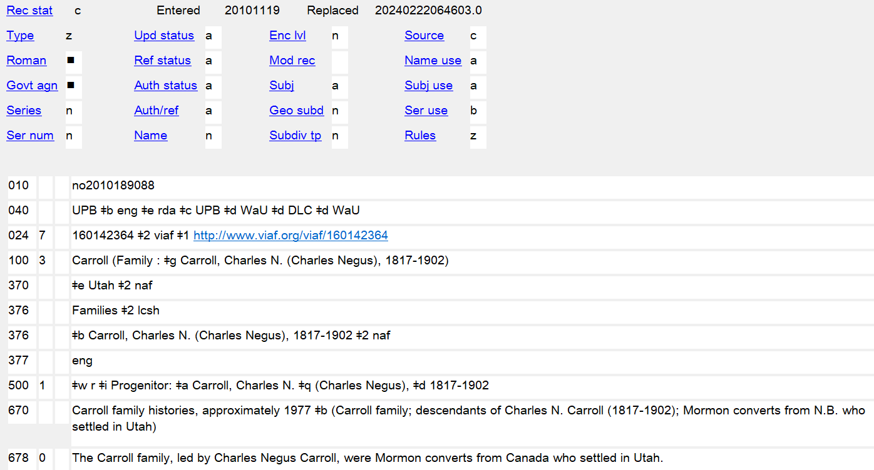
Notes:
October 4, 2024: replaced screenshot showing $2 lcsh in 376 $a
August 16, 2023: updates notes to indicate that URIs may be added
Dec. 23, 2020: Edited speaker notes to remove references to 024 moratorium
March 3, 2020: new slide
LCCN in 010 is added automatically
Other identifiers may be recorded in 024. See NACO 024 Best Practices Guidelines.

Slide 85
Constructing the Authorized Access Point (RDA 10.11.1)
1. Record the Preferred name in subfield $a of the 100 field
100 3_ Coniglio
2. Add the type of family following an opening parenthesis (do not use controlled vocabulary). There is no additional subfield coding.
100 3_ Coniglio (Family
Notes:
December 15, 2016
Participants: add type of family to the authorized access points in your three worksheets/work forms. Do not use controlled vocabulary—the term may not match what was recorded in 376 $a.

Slide 86
Constructing the Authorized Access Point (RDA 10.11.1)
3. Following space-colon-space $d, add the Date Associated with the Family element, if one was recorded. Normally record only the year(s).
100 3_ Coniglio (Family : $d 1912-
If the access point is now unique and doesn’t conflict with any other family access point, you can stop here:
100 3_ Coniglio (Family : $d 1912- )
Notes:
October 4, 2024: added second paragraph to the slide, and additional instructor notes
December 15, 2016
Participants: add the date you recorded in 046 (year only) to the authorized access points in your three worksheets/work forms.
RDA 10.11.1.1: Include the elements specified at 10.11.1.2 (Type of Family)–10.11.1.3 (Date Associated with Family) even if they are not needed to distinguish access points representing different families with the same name.
RDA requires both type of family and associated date in authorized access points. Dates can be approximate or can be less specific century dates, so in most cases a cataloger ought to be able to record some kind of date. If after adding the type of family and associated date(s) the access point is unique, the cataloger could stop here. Add a closing parenthesis to the access point.

Slide 87
Constructing the Authorized Access Point (RDA 10.11.1)
4. Following space-colon-space, add the Place and/or Prominent Member element, in that order, if necessary to distinguish from another access point, or if it assists in identifying the family
  Record places in subfield $c
    100 3_ Coniglio (Family : $d 1912- : $c Robertsdale, Pa.)
  Record prominent member in subfield $g
  100 3_ Coniglio (Family : $d 1912- : $g Coniglio, Gaetano,
  1889-1944)
Notes:
October 4, 2024: revised slide and speaker notes
March 20, 2017: updated speaker notes
If necessary to distinguish from another access point, include the Prominent Member when a Place is not available (RDA 10.11.1.5).
Two possible ways to establish the Coniglio family name. It would also be possible to use Rosa as the prominent member if it was judged that she was more prominent than Gaetano or would better identify the family. Similarly, Serradifalco, Italy might have been chosen for the place. If it is thought necessary, different versions of the qualifier can be recorded in variant access points for the family.
Probably best not to go beyond 3 elements in the qualifier, even though RDA does not limit. You can always add variant access points to bring out other elements in the qualifier. The order of additions is always: Type of Family, then Date, then Place, then Prominent Member. If all elements were deemed necessary or important for identification, the example would look like:
100 3_ Coniglio (Family : $d 1912- : $c Robertsdale, Pa. : $g Coniglio, Gaetano, 1889-1944)
Participants: complete the authorized access points in your three worksheets/work forms by adding a place or prominent member.

Slide 88
Authorized Access Point
(Coniglio)
046 $s 1912-11-30 [or 1913-04-30] $2 edtf
100 3_ Coniglio (Family : $d 1912- : $g Coniglio, Gaetano, 1889-1944) [or use Rosa, or use a place]
370 $e Serradifalco (Italy) $e Robertsdale (Pa.) $2 naf
376 Families $2 lcsh
376 $b Coniglio, Gaetano, 1889-1944 $b Coniglio, Rosa Alessi, 1893-1972
377 eng
670 The Coniglio family website, 8 April 2014 $b (Coniglio family, descendants of Gaetano and Rosa Alessi Coniglio, who married 30 November 1912 in Serradifalco, Italy and emigrated to the United States 30 April 1913; the family settled in Robertsdale, Pennsylvania)
Notes:
October 4, 2024: changed $2 to lcsh because Families is no longer a valid heading in LCDGT (changed in 2024 to Family members)
August 12, 2019: added Alessi to Rosa Coniglio
March 1, 2019: changed 370 subfield coding to $e
February 5, 2019: changed Families 376 to $2 lcdgt to encourage usage of LCDGT

Slide 89
Authorized Access Point
(Cunningham)
046 $s 1795 [or you might choose 1818, when they arrived in Kentucky] $2 edtf
100 3_ Cunningham (Family : $d 1795- : $c Trigg County, Ky.) [or record prominent member
370 $e Trigg County (Ky.) $2 naf $s 1818
376 Families $2 lcsh
376 $b Cunningham, William, 1765-1823 $b Cunningham, Nancy, 1776-1830 $2 naf
377 eng
670 The Cunningham family cookbook, 1997: $b pages 5-6 (descendants of William and Nancy Cunningham. William emigrated from Scotland some time after 1785 and married Nancy Carr in 1795. The family settled in Trigg County, Kentucky in 1818)
Notes:
October 4, 2024: changed $2 to lcsh because Families is no longer a valid heading in LCDGT (changed in 2024 to Family members)
March 1, 2019: changed 370 subfield coding to $e
February 5, 2019: changed 376 by adding $2 lcdgt to encourage usage of LCDGT

Slide 90
Authorized Access Point
(Linnell)
046 $s 1638 $2 edtf
100 3_ Linnell (Family : $d 1638- : $c North America) [or use prominent member]
370 $e North America $e Cape Cod (Mass.) $2 lcsh
370 $e Scituate (Mass.) $e Barnstable (Mass.) $e Massachusetts $c United States $2 naf [all possible, but probably not all would be recorded]
376 Families $2 lcsh
376 $b Linnell, Robert, 1584-1662 $2 naf
377 eng
670 Linnell family newsletter, April 1991.
670 Linnell Family Association website, 8 April 2014 $b (The Linnell family consists of all Linnells in North America, all presumed to be descendants of Robert Linnell, who came to Scituate, Massachusetts with his children and second wife in 1638. The family later settled on Cape Cod)
Notes:
October 4, 2024: changed $2 to lcsh because Families is no longer a valid heading in LCDGT (changed in 2024 to Family members)
March 1, 2019: changed format of first 670; changed 370 subfield coding to $e
February 5, 2019: changed 376 by adding $2 lcdgt to encourage usage of LCDGT

Slide 91
Constructing a Variant Access Point (RDA 10.11.2)
1. Record a variant name (RDA 10.2.3) or the preferred name (RDA 10.2.2) for the family in 400 subfield $a (and $c if necessary)
2. Following an opening parenthesis, add a term indicating the type of family
    100 3_ Shrewsbury (Family : $c Great Britain)
    400 3_ Shrewsbury, $c Earls of (Family)
    100 3_ Von Braun (Family : $d 1880-1912 : $c N.Y.)
    400 3_ Braun (Family)
Notes:
May 23, 2018
Any name, including the preferred name, can be used as the basis for a variant access point.
Note (to bring up only if somebody in the class notices): the RDA to MARC mapping in the Toolkit doesn’t take into account the situation found with the Shrewsbury 400; it only maps type of family to $a, but in this case it winds up in $c.

Slide 92
Constructing the Variant Access Point (RDA 10.11.2)
3. Add date, place, or prominent member elements as appropriate.
    100 3_ Shrewsbury (Family : $c Great Britain)
    400 3_ Shrewsbury, $c Earls of (Family : Great Britain)
    100 3_ Von Braun (Family : $d 1880-1912 : $c N.Y.)
    400 3_ Braun (Family : $d 1880-1912 : $c N.Y.)
Notes:
August 9, 2019: removed second $c in first 400. $c is repeatable in some cases, but not in this one
September 17, 2018: “as appropriate” replaced “if considered important for identification” in RDA instructions in April 2017; updated speaker notes
Include additional elements as if it were an authorized access point; any or all additions that would be allowed in the authorized access point are appropriate in the variant access point as well.
MARC 21 X00 $c:
Multiple adjacent titles or words associated with a name are contained in a single subfield $c. Subfield $c is repeated only when words associated with a name are separated by subelements contained in other subfields.

Slide 93
Constructing the Variant Access Point (RDA 10.11.2)
Variant access points with different choices of qualifiers may also be recorded, if considered useful for identification
      100 3_ Coniglio (Family : $d 1912- : $c Robertsdale, Pa.)
      400 3_ Coniglio (Family : $d 1912- : $g Coniglio, Gaetano, 1889-1944)
      400 3_ Coniglio (Family : $d 1912- : $g Coniglio, Rosa Alessi, 1893-1972)
Notes:
August 12, 2019: added second 400 to show that variant access points could be made for both prominent members of the family

Slide 94
Related Persons (RDA 30)
Related persons are recorded in 500 fields, and may include a relationship designator in subfield $i (from RDA Appendix K), with $w r. The related person must be established in the LC/NACO Authority File.
046 $s 1795 [or you might choose 1818, when they arrived in Kentucky] $2 edtf
100 3_ Cunningham (Family : $d 1795- : $c Trigg County, Ky.) [or record prominent member
370 $e Trigg County (Ky.) $2 naf $s 1818
376 Families $2 lcsh
376 $b Cunningham, William, 1765-1823 $b Cunningham, Nancy, 1776-1830 $2 naf
377 eng
500 1_ $w r $i Progenitor: $a Cunningham, William, $d 1765-1823
500 1_ $w r $i Progenitor: $a Cunningham, Nancy, $d 1776-1830
Notes:
October 4, 2024: changed $2 to lcsh because Families is no longer a valid heading in LCDGT (changed in 2024 to Family members)
March 1, 2019: changed 370 subfield coding to $e
February 5, 2019: changed 376 by adding $2 lcdgt to encourage usage of LCDGT

Slide 95
Related Families (RDA 31)
Related families are also recorded in 500 fields. You may include a relationship designator in subfield $i (from RDA Appendix K) with $w r, or, for predecessor/successor families, use simple see also coding. The related family must be established in the LC/NACO Authority File.
      100 3_ Taylor (Family : $g Taylor, Isaac, 1730-1807)
      500 3_ $w r $i Descendant family: $a Taylor (Family : $d 1759-1901 : $c Chipping Ongar, England)
      100 3_ Windsor (Royal house : $d 1917- : $c Great Britain)
      500 3_ Saxe-Coburg and Gotha (Royal house : $d 1901-1917 : $c Great Britain)
Notes:
October 4, 2024: changed RDA Beta Toolkit in notes to Official RDA and added info on relationship labels for predecessor/successor families
March 3, 2020: substituted an established example as the second example and changed coding to simple see also reference; revised speaker notes to suggest including 667 and/or 678 notes
August 12, 2019: added note about new RDA Beta Toolkit relationship elements for predecessor/successor of family
March 1, 2019: corrected form in first 500
In the Windsor/Saxe-Coburg and Gotha case, since there aren’t earlier/later relationship designators for families in Appendix K, we need to use simple see also coding ($w a/$w b coding does not validate in OCLC). When simple see also references are used, it may be helpful to explain the nature of the relationship in a 667 nonpublic general note and/or a 678 biographical note. For example:
678 0_ The House of Windsor is the royal house of the United Kingdom. The dynasty includes Edward VII (reigned 1901-10), George V (1910-36), Edward VIII (1936), George VI (1936-52), and Elizabeth II (1952- ). It was founded by King George V on 17 July 1917 when he changed the name from Saxe-Coburg and Gotha to Windsor because of anti-German sentiment in the United Kingdom during World War I.
Note: In Official RDA, there are new relationship elements for predecessor of family and successor of family, which could be used once the Official RDA is implemented. According to the Metadata Guidance Documentation for family to family relationship labels (https://www.loc.gov/aba/rda/mgd/relationshipLabels/mg-rl-family-family.pdf), the relationship labels “predecessor” and “successor” will be used in $i.

Slide 96
Related Corporate Bodies (RDA 32)
Related corporate bodies are recorded in 510 fields. You may include a relationship designator in subfield $i (from RDA Appendix K), with $w r. The related corporate body must be established in the LC/NACO Authority File.
  100 3_ Linnell (Family : $d 1638- : $c North America)
  510 2_ $w r $i Founded corporate body of family: $a Linnell Family Association
Notes:
September 17, 2018: moved $w to beginning of 500 fields.
March 20, 2017: updated relationship designator to use term from RDA Appendix K.4.2

Slide 97
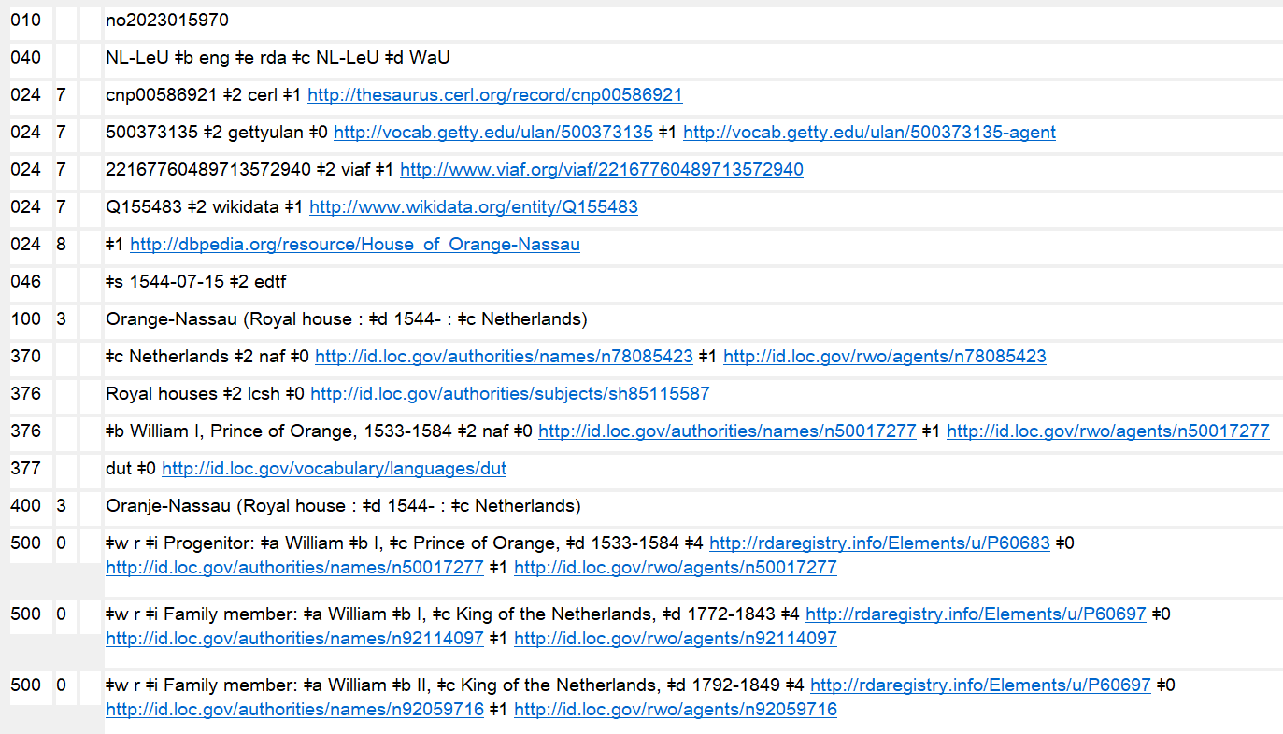
URIs in 3XX and 5XX
Notes:
July 30, 2025: updated speaker notes
October 4, 2024: new slide
URIs may be added to 3XX and 5XX fields in accordance with PCC guidelines and best practices. Tools such as the Authority Toolkit (https://files.library.northwestern.edu/public/oclc/documentation/) may be used to automatically add URI subfields. Record authority record URIs in subfield $0, real world object URIs in $1, and relationship designator URIs in $4. The recommended order of subfields is $2 $4 $0 $1. When using RDA relationship URIs in $4, use unconstrained property URIs from the RDA Registry (https://www.rdaregistry.info/Elements/u/). Consult the URIs in MARC Pilot Resource Documents & Tools website (https://wiki.lyrasis.org/pages/viewpage.action?pageId=178881300), but note that PCC documentation on URIs is currently in the process of being revised and updated.
URIs were originally added as part of the PCC’s URIs in MARC Pilot project. The 667 note “URIs added to this record for the PCC URI MARC Pilot. Please do not remove or edit the URIs” is no longer required and may be deleted when a record is being revised for any reason.
Reminder: Any authorized access point given in a 5XX field must be established in its own authority record.
$0 - authority URI
$1 - real world object URI
$4 - relationship URI

Slide 98
Exercise
Complete the authority records for the Cunningham, Coniglio and Linnell families
Notes:
May 1, 2013
Possible answers coming up on following slides. These three slides are in the Answers section of the trainees’ manuals.

Slide 99
RDA authority record core and non-core
040 [MARC organization code] $b eng $e rda $c [MARC organization code]
046 $s 1912-11-30 [or 1913-04-30] $2 edtf
100 3_ Coniglio (Family : $d 1912- : $g Coniglio, Gaetano, 1889-1944) [or use Rosa, or use a place]
370 $e Serradifalco (Italy) $e Robertsdale (Pa.) $2 naf
376 Families $2 lcsh
376 $b Coniglio, Gaetano, 1889-1944 $b Coniglio, Rosa Alessi, 1893-1972
377 eng
[possible 400s]
400 3_ Coniglio (Family : $d 1912- : $g Coniglio, Rosa Alessi, 1893- )
400 3_ Coniglio (Family : $d 1912- : $c Robertsdale, Pa.)
400 3_ Coniglio (Family : $d 1912- : $c Serradifalco, Italy)
670 The Coniglio family website, [date of viewing] $b (Coniglio family, descendants of Gaetano and Rosa Alessi Coniglio, who married 30 November 1912 in Serradifalco, Italy and emigrated to the United States 30 April 1913; the family settled in Robertsdale, Pennsylvania)
678 0_ Gaetano and Rosa Coniglio founded the Coniglio family in 1912. The family later settled in Robertsdale, Pennsylvania.
Notes:
October 4, 2024: changed 376 $2 from lcdgt to lcsh because of change of LCDGT term Families to Family members
November 22, 2019: spelled out “Pennsylvania” in 678
August 12, 2019: added Alessi to Rosa Coniglio
March 1, 2019: changed 370 subfield coding to $e
February 5, 2019: changed Families 376 to $2 lcdgt to encourage usage of LCDGT
Note very little is core or required in an RDA record. Institutions may declare other elements to be core. For example, the first source consulted (670) is core for PCC. (Language of cataloging is marked in the index as core but not in the rules themselves)
Note: the date in 046 could have been $s 1913-04-30. Only one $s per 046 allowed. Also the date in 100 could have been 1913 (if that was the date chosen for 046)

Slide 100
RDA authority record core and non-core
040 [MARC organization code] $b eng $e rda $c [MARC organization code]
046 $s 1795 $2 edtf
100 3_ Cunningham (Family : $d 1795- : $c Trigg County, Ky.) [or record prominent member]
370 $e Trigg County (Ky.) $2 naf $s 1818
376 Families $2 lcsh
376 $b Cunningham, William, 1765-1823 $b Cunningham, Nancy, 1776-1830 $2 naf
377 eng
[possible 400s]
400 3_ Cunningham (Family : $d 1795- : $g Cunningham, William, 1765-1823)
400 3_ Cunningham (Family : $d 1795- : $g Cunningham, Nancy, 1776-1830)
500 1_ $w r $i Progenitor: $a Cunningham, William, $d 1765-1823
500 1_ $w r $i Progenitor: $a Cunningham, Nancy, $d 1776-1830
670 The Cunningham family cookbook, 1997: $b pages 5-6 (descendants of William and Nancy Cunningham. William emigrated from Scotland some time after 1785 and married Nancy Carr in 1795. The family settled in Trigg County, Kentucky in 1818)
678 0_ The Cunningham family consists of descendants of William and Nancy Cunningham, who married in 1795 and later settled in Trigg County, Kentucky.
Notes:
October 4, 2024: changed 376 $2 from lcdgt to lcsh because of change of LCDGT term from Families to Family members
November 22, 2019: spelled out “Kentucky” in 678
March 1, 2019: changed 370 subfield coding to $e
February 5, 2019: changed Families 376 to $2 lcdgt to encourage usage of LCDGT
Note very little is core or required in an RDA record. Institutions may declare other elements to be core. For example, the first source consulted (670) is core for PCC. (Language of cataloging is marked in the index as core but not in the rules themselves)

Slide 101
RDA authority record core and non-core
040 [MARC organization code] $b eng $e rda $c [MARC organization code]
046 $s 1638 $2 edtf
100 3_ Linnell (Family : $d 1638- : $c North America)
370 $e North America $e Cape Cod (Mass.) $2 lcsh
370 $e Scituate (Mass.) $e Barnstable (Mass.) $e Massachusetts $c United States $2 naf [all possible, probably not all would be on any description]
376 Families $2 lcsh
376 $b Linnell, Robert, 1584-1662 $2 naf
377 eng
[some of the possible 400s]
400 3_ Linnell (Family : $d 1638- : $c Cape Cod, Mass.)
400 3_ Linnell (Family : $d 1638- : $g Linnell, Robert, 1584-1662)
500 1_ $w r $i Progenitor: $a Linnell, Robert, $d 1584-1662
  510 2_ $w r $i Founded corporate body of family: $a Linnell Family Association
670 Linnell family newsletter, April 1991.
670 Linnell Family Association website, [date of viewing] $b (The Linnell family consists of all Linnells in North America, all presumed to be descendants of Robert Linnell, who came to Scituate, Massachusetts with his children and second wife in 1638. The family later settled on Cape Cod)
  678 0_ The Linnell family consists of all Linnells in North America, all presumed to be descendants of Robert Linnell (1584-1662) who settled in Massachusetts in 1638.
Notes:
October 4, 2024: changed 376 $2 from lcdgt to lcsh because of change of LCDGT term from Families to Family members
November 22, 2019: added final parenthesis in second 670
March 1, 2019: changed format of first 670; changed 370 subfield coding to $e
February 5, 2019: changed 376 by adding $2 lcdgt to encourage usage of LCDGT
Note very little is core or required in an RDA record. Institutions may declare other elements to be core. For example, the first source consulted (670) is core for PCC. (Language of cataloging is marked in the index as core but not in the rules themselves)

Slide 102
Exercises
Create descriptions for other names associated with books you have brought
We can do some of these together in the LC/NACO Authority File
Notes:
May 1, 2013

Slide 103
Module 3
Describing Families
Questions?
Notes:
May 1, 2013

